Slide 1
BITCOIN PRICES PROJECT
PROJECT-2_Team-A

Slide 2
Abstract
The project uses a dataset named "bitcoin_prices2.csv" containing historical Bitcoin price data. The first step of the project is to is load it into a Pandas and pre-processes the data, which involves handling missing values, converting the date columns to a datetime format, and dropping unnecessary columns. Data visualization is then performed using various plots to understand the trend and distribution of Bitcoin prices across different years, months, and other relevant features. The data is then visualized using Seaborn and Matplotlib.
Next, a simple linear regression model using Scikit-learn is trained using the pre-processed data to predict Bitcoin prices. The data is split into training and testing sets, and the model is trained on the training set using scikit-learn's LinearRegression module. The model's performance is evaluated on the testing set using mean squared error (MSE) and R-squared score metrics.

Slide 3
Finally, the trained model is deployed to predict Bitcoin prices for new data. The model takes in the input features for new data, pre-processes it, and predicts the Bitcoin price using the trained model.
Overall, the project aims to provide insights into the trend and distribution of Bitcoin prices and develop a predictive model that can accurately predict Bitcoin prices based on input features.

Slide 4
PROBLEM DEFINITION
Bitcoin is a highly volatile digital currency that experiences frequent price fluctuations, making it challenging to predict its future price accurately. As a result, investors and traders are always looking for ways to predict Bitcoin's price movements to make informed investment decisions. This project aims to solve this problem by developing a machine learning model that can predict Bitcoin's future price based on historical price data and other relevant features.
To achieve this goal, the project will use Python and several data analysis libraries such as pandas, NumPy, scikit-learn (sklearn), seaborn, and Matplotlib. The project will start by analyzing the trend and distribution of Bitcoin prices across different years, months, and other relevant features. The analysis will provide insights into the factors that affect the price of Bitcoin and how they influence the predictive model.

Slide 5
The project will then proceed to develop a machine learning model using scikit-learn to predict Bitcoin's future price based on input features. The machine learning model will be trained on historical price data and relevant features, and its performance will be evaluated using mean squared error and r-squared metrics.
Finally, the project will develop a user-friendly application that can predict Bitcoin's future price based on input features for new data. The application will leverage the trained machine learning model to provide accurate predictions of Bitcoin prices. The project aims to help investors and traders make informed investment decisions by providing accurate predictions of Bitcoin prices.

Slide 6
EXISTING SYSTEM
Before the advent of machine learning, predicting the price of Bitcoin was done mainly through technical analysis. Technical analysis involves studying past market data, primarily price and volume, to identify patterns and trends that can be used to predict future market movements.
This approach is based on the assumption that the market will repeat patterns, and that these patterns can be used to make informed trading decisions. However, technical analysis has several limitations.
Firstly, it can be subjective, as different analysts may interpret the same data differently. Secondly, it does not account for the impact of external factors such as news events, regulatory changes, or shifts in market sentiment. Finally, technical analysis does not adapt well to changing market conditions, which can result in inaccurate predictions.

Slide 7
PROPOSED SYSTEM
With the rise of machine learning, it has become possible to build models that can take into account a wide range of factors to predict the price of Bitcoin with greater accuracy. These models can be trained on vast amounts of historical data, allowing them to identify patterns and trends that are not readily apparent to human analysts.
Additionally, machine learning models can incorporate new data in real-time, allowing them to adapt to changing market conditions and make more accurate predictions. This makes machine learning a valuable tool for traders and investors who are looking to make informed decisions about buying and selling Bitcoin.
Overall, the goal of these existing systems is to provide traders and investors with accurate and reliable predictions of bitcoin prices. However, no system can predict the future with 100% accuracy, and bitcoin prices can be highly volatile and unpredictable. Therefore, it is important to approach bitcoin price prediction with caution and use a variety of tools and techniques to make informed investment decisions.

Slide 8
SYSTEM REQUIREMENTS
Hardware Requirements:
The code does not require high-end hardware to run. However, it may take longer to run on slower machines or with large datasets. So, a computer with a decent processor and RAM should suffice.
Input Device: Keyboard, Mouse
Output Device: Monitor

Slide 9
Software Requirements:
Platform: Windows/ Linux
Python: The code is written in Python, so you need to have Python installed on your system. You can download and install Python from the official Python website https://www.python.org/downloads/.
Python Libraries: The code uses several Python libraries such as pandas, numpy, seaborn, matplotlib, and sklearn. You need to make sure that these libraries are installed on your system. You can install these libraries using the pip package manager in the command line. For example, to install pandas, you can run the command "pip install pandas".
Dataset: The code requires a dataset named 'bitcoin_prices2.csv' to be present in the working directory. You need to make sure that the dataset is downloaded and saved in the correct format in the working directory.

Slide 10
MODULE – WISE EXPLAINATION
Bitcoin Prices – Team a

Slide 11
Module-1_Problem Definition and Design Thinking
Summary:
Module-1 for the Bitcoin Prices project is focused on developing an accurate predictive model for Bitcoin prices, using historical data and external factors like news sentiment scores, social media sentiment scores, and economic indicators. The objectives of the project include developing an accurate model, incorporating external factors, evaluating different algorithms, deploying the model in real-time, and continuously assessing and improving the model's performance. The dataset can be found on Kaggle. The project will use Python 3.10, along with Pandas, Numpy, Matplotlib, and Seaborn libraries, on a Windows 10 system. The design thinking approach will be followed, including researching user needs, defining the problem scope and data, brainstorming potential solutions, prototyping and testing the model, and monitoring and improving its performance over time. The dataset used for the project

Slide 12


Slide 13
Module-2_Innovation and Problem Solving
Summary:
Module-2 involves documentation by using machine learning to predict Bitcoin prices. They plan to collect historical data, clean and preprocess it, engineer relevant features, select and train a suitable model, evaluate its performance, fine-tune it as needed, and deploy it for making predictions on new data. They will use various sources for data collection, and consider algorithms such as regression models, decision trees, and neural networks for model selection. Hence, Our goal is to accurately predict Bitcoin prices using machine learning.

Slide 14


Slide 15
Module-3_Import the Dataset and Cleaning
The code in module-3 imports the necessary libraries NumPy and Pandas and reads a CSV file named 'bitcoin_prices2.csv' into a Pandas DataFrame 'df'. Then, it performs data cleaning by checking for missing values using 'isnull().sum()' and checking for duplicate data using 'duplicated().sum()'. Both checks return 0, indicating that there are no missing values or duplicate data in the DataFrame. Finally, it displays the first five and last five rows of the DataFrame using 'df.head()' and 'df.tail()’.

Slide 16
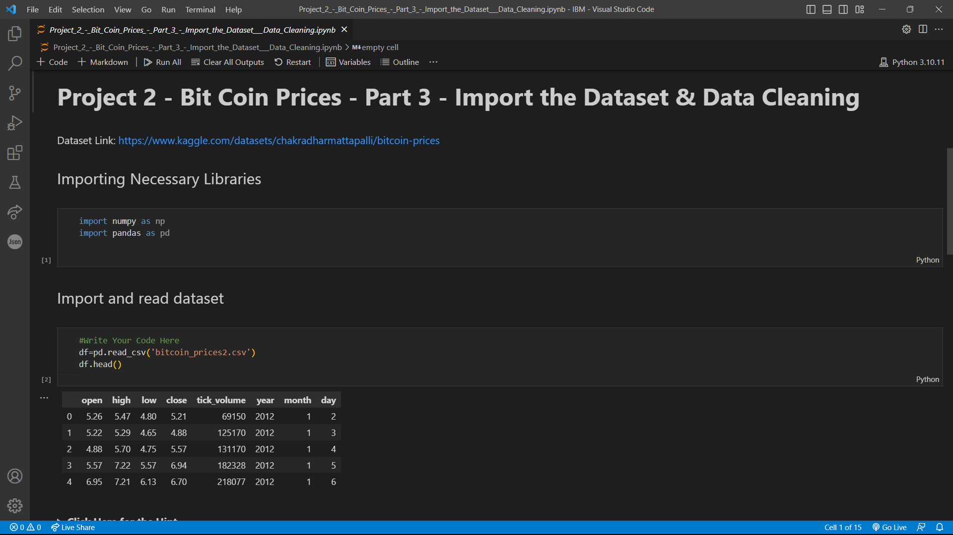

Slide 17
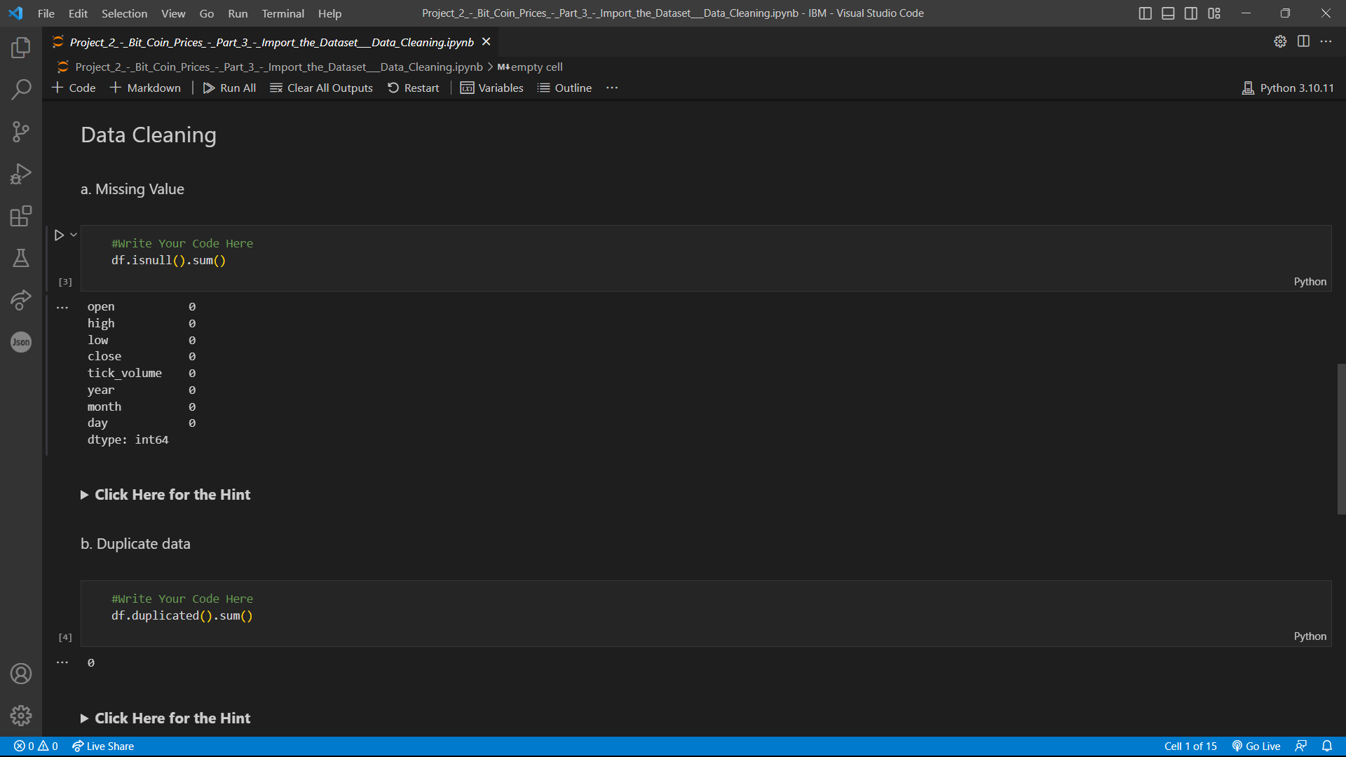

Slide 18
Module-4_Perform Data Analysis
Summary:
First, it imports the necessary libraries (NumPy and Pandas) and reads in the dataset from a CSV file. It then checks for missing values and duplicates, finding none.
The code then answers several questions about the data:
It calculates the average closing price of the stock for each month in the year, using the groupby function to group the data by month and calculate the mean of the close column.
It calculates the average daily price range (high - low) for a given month and year. This is done by filtering the data for the desired month and year, calculating the daily price range, and taking the mean of the resulting price_range column.
It calculates the total tick volume for each year in the dataset, using the groupby function to group the data by year and summing the tick_volume column for each year.
The resulting outputs are printed to the console.

Slide 19
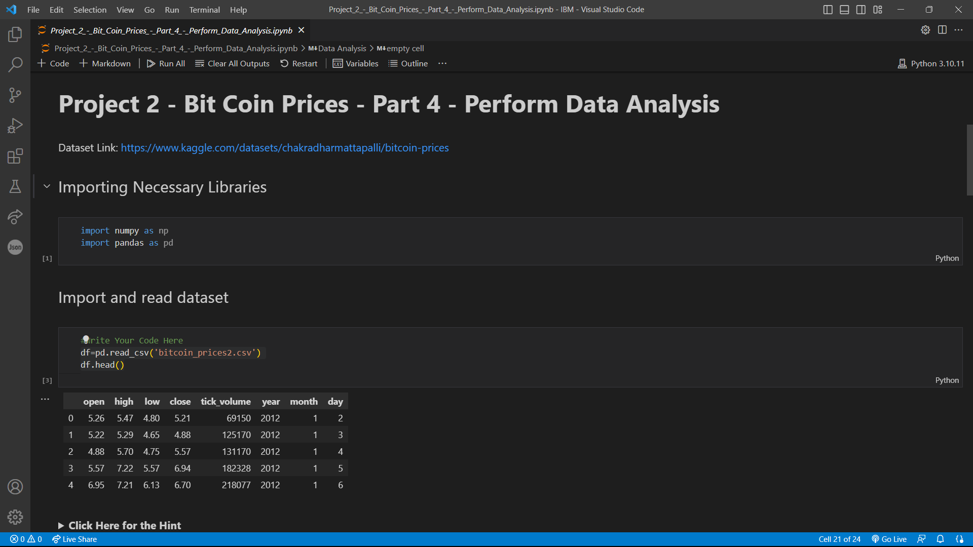

Slide 20
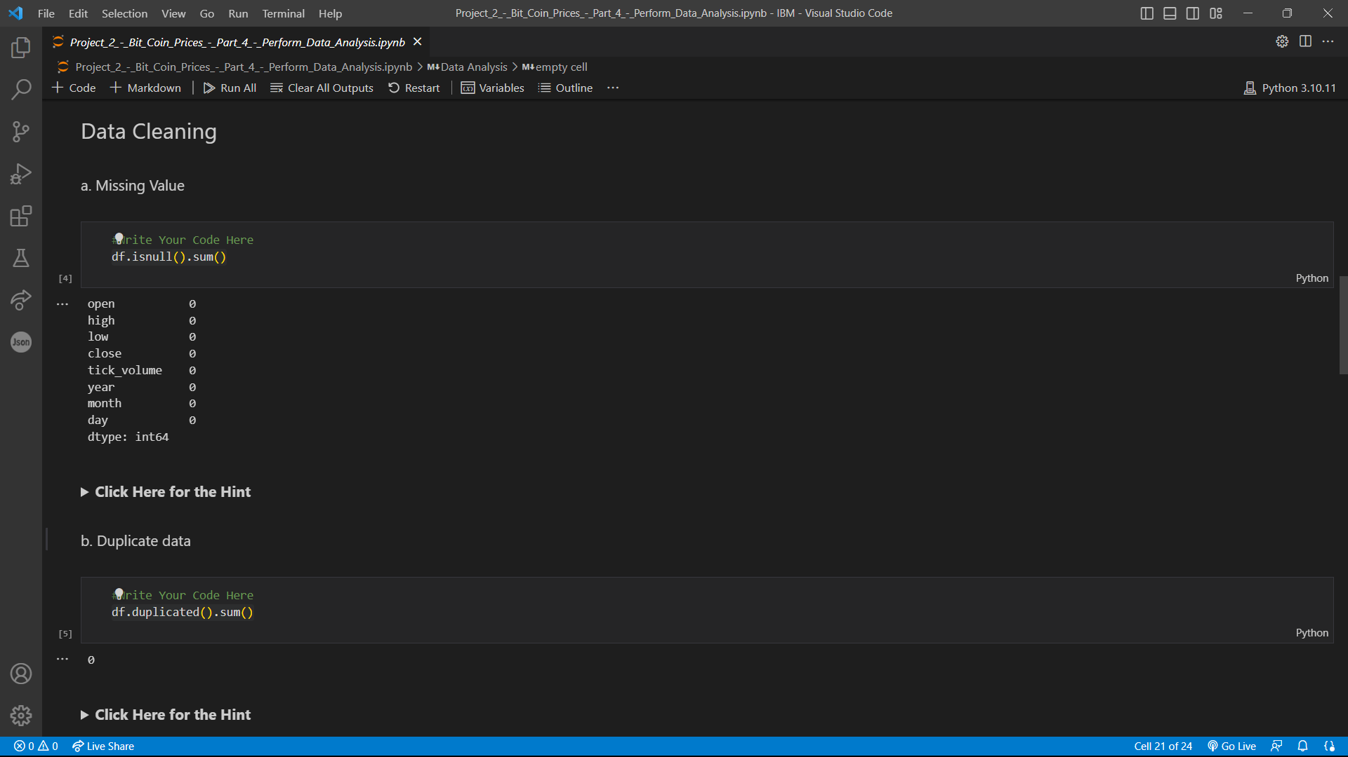

Slide 21
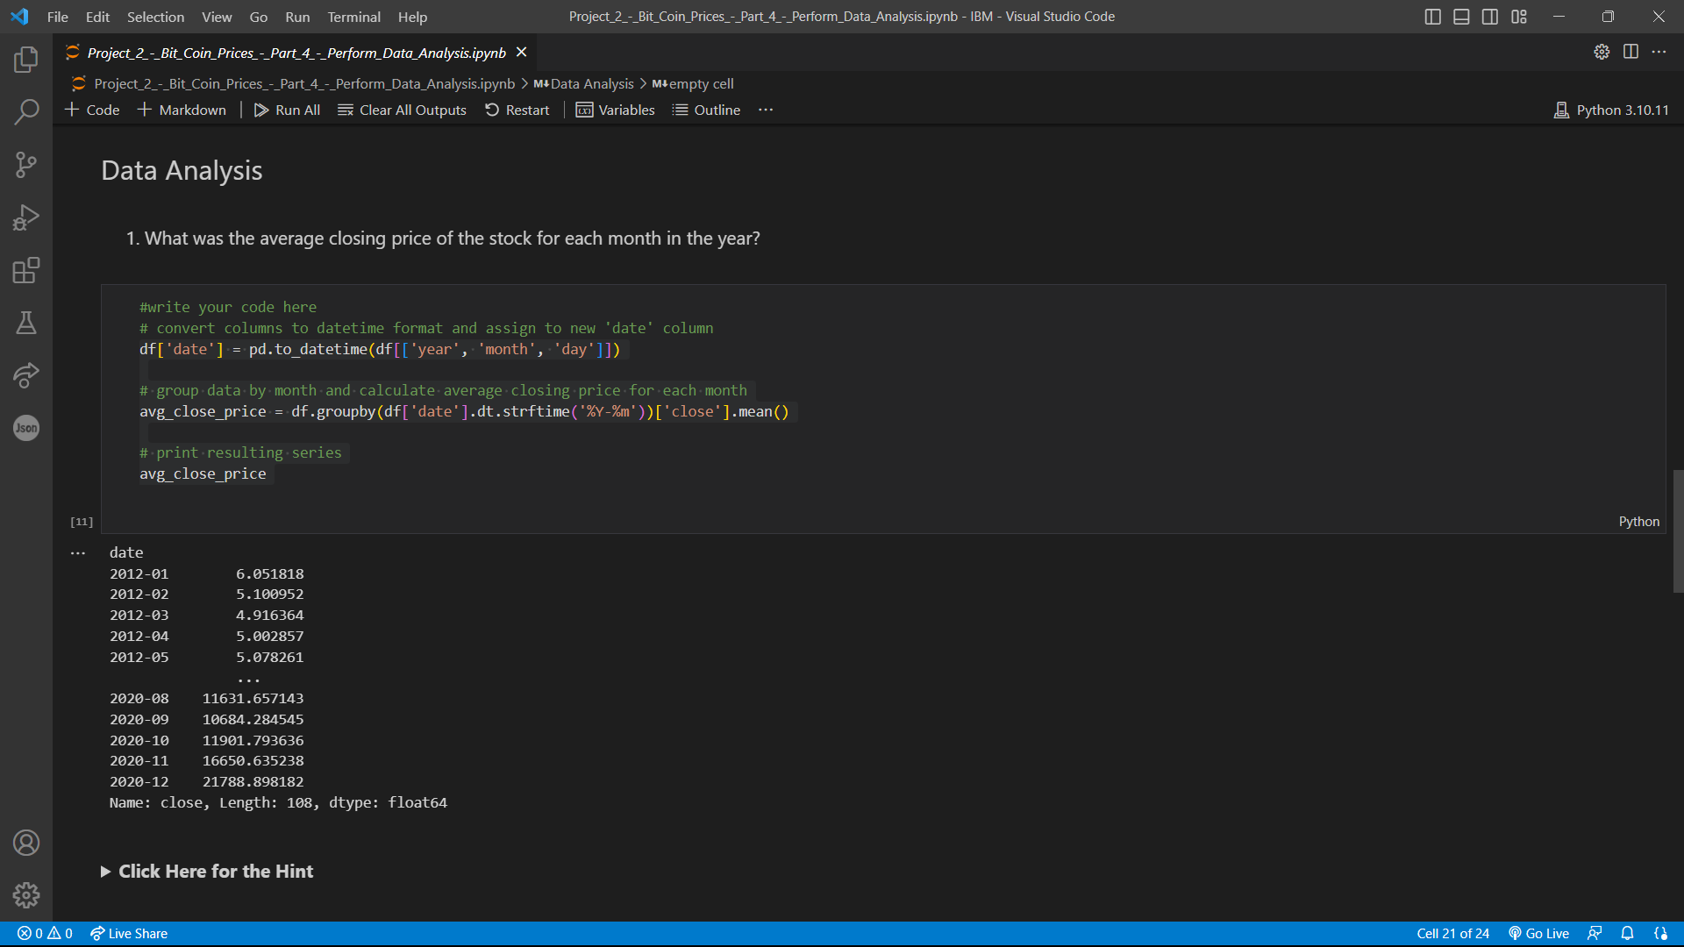

Slide 22
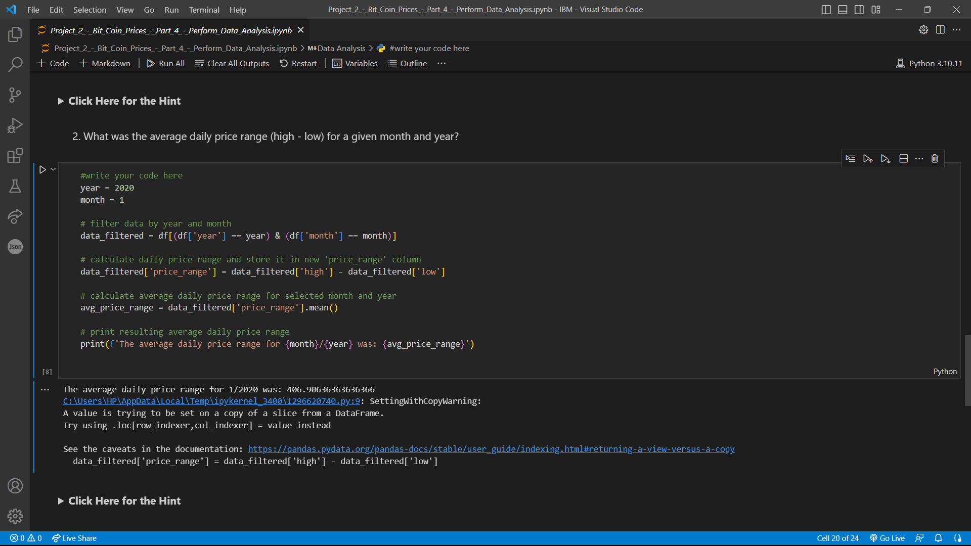

Slide 23
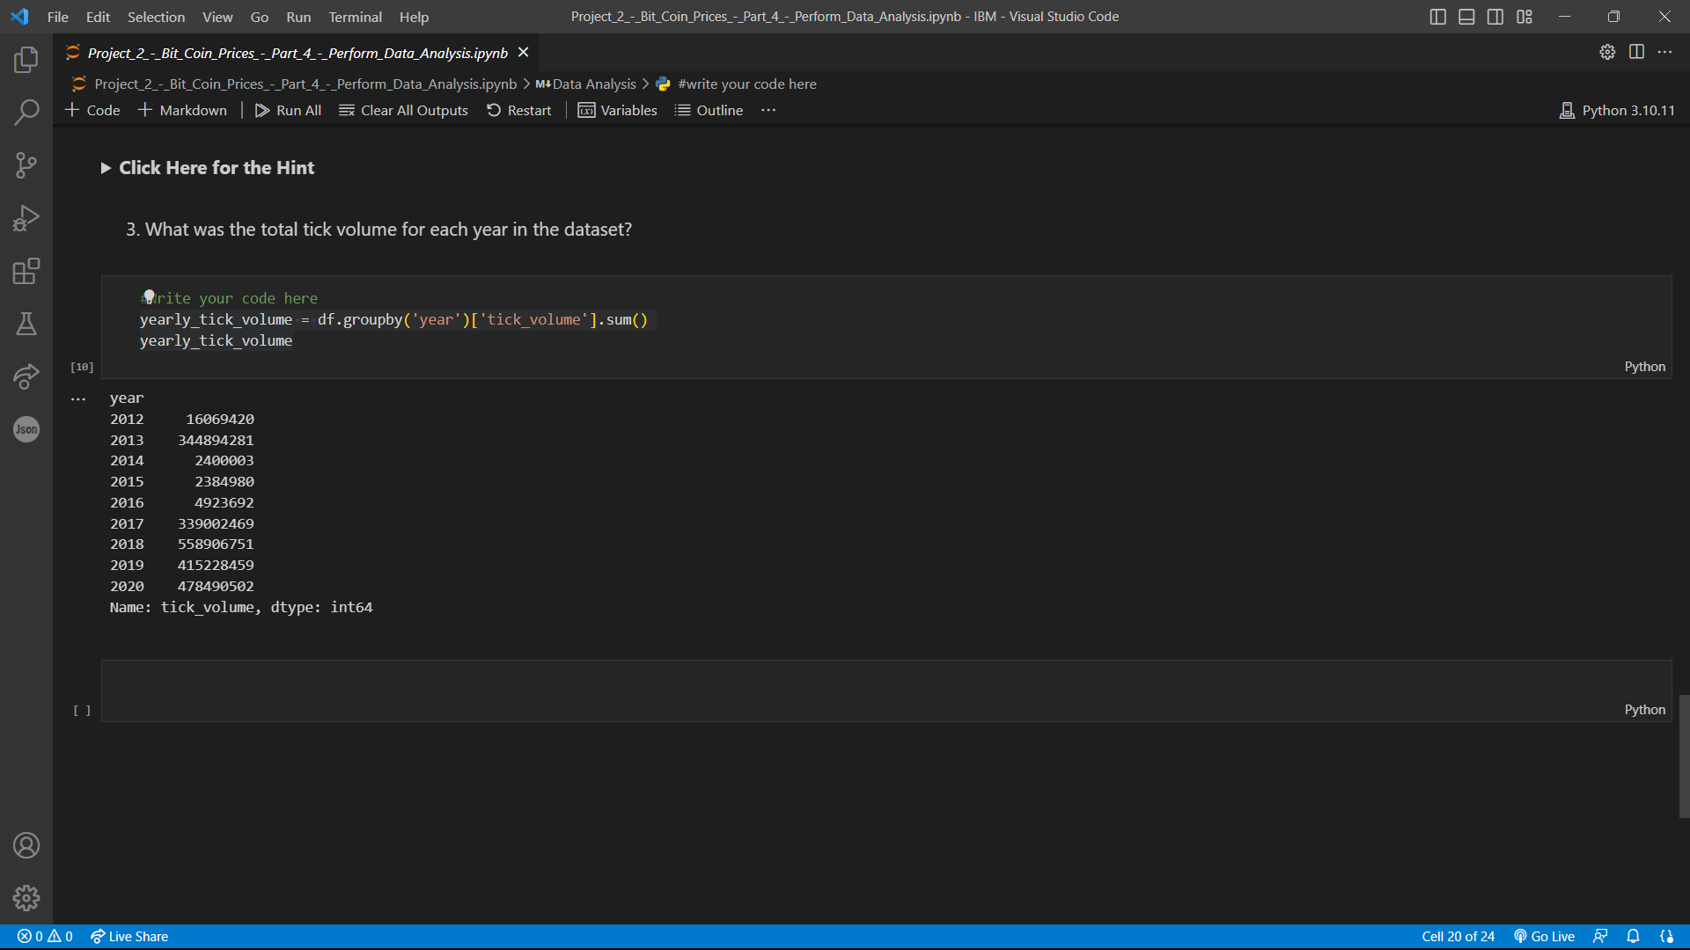

Slide 24
Module-5_Perform Data Visualization
Summary:
The code imports the necessary libraries, reads a Bitcoin price dataset from a CSV file, cleans the data for missing values and duplicates, performs some basic data analysis, and creates a visualization.
In the data analysis section, the code calculates the average closing price of the Bitcoin stock for each month in the year, the average daily price range (high-low) for a given month and year, and the total tick volume for each year in the dataset.
Finally, in the data visualization section, the code groups the data by year and calculates the mean value for each column, then creates a line plot to visualize the trend of each column over time.

Slide 25
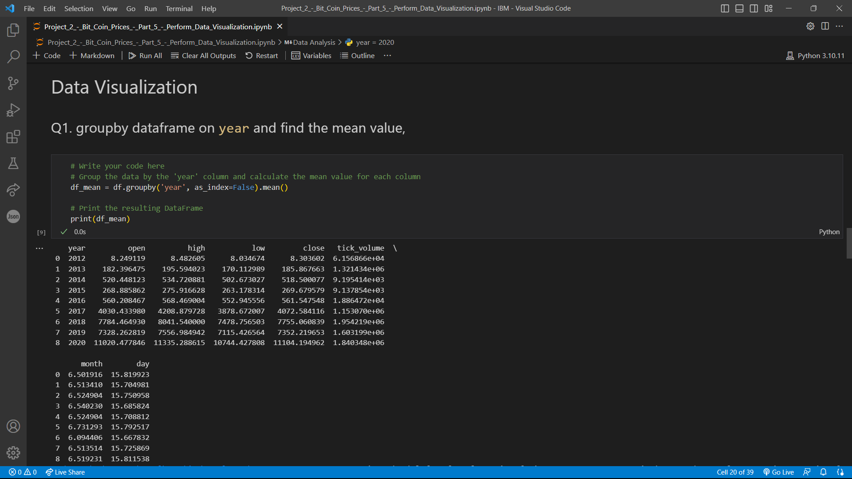

Slide 26
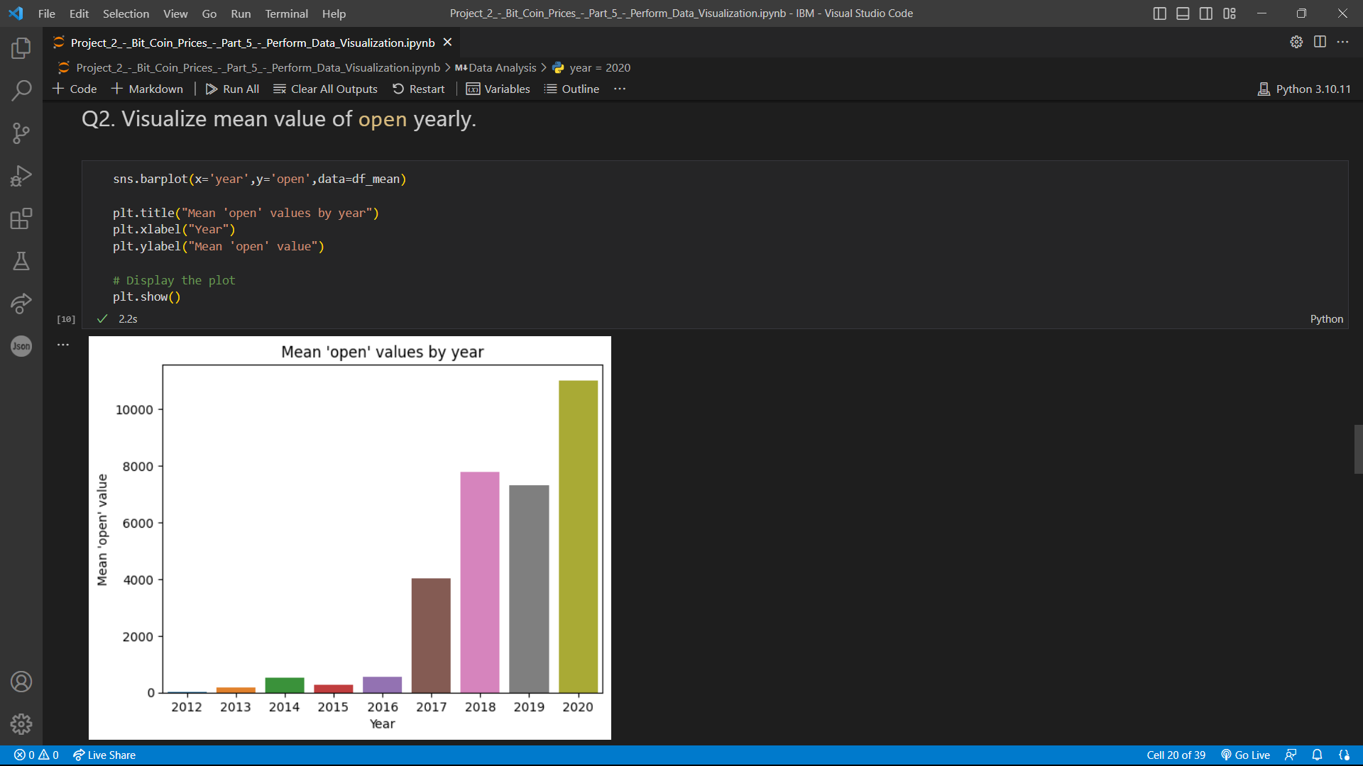

Slide 27
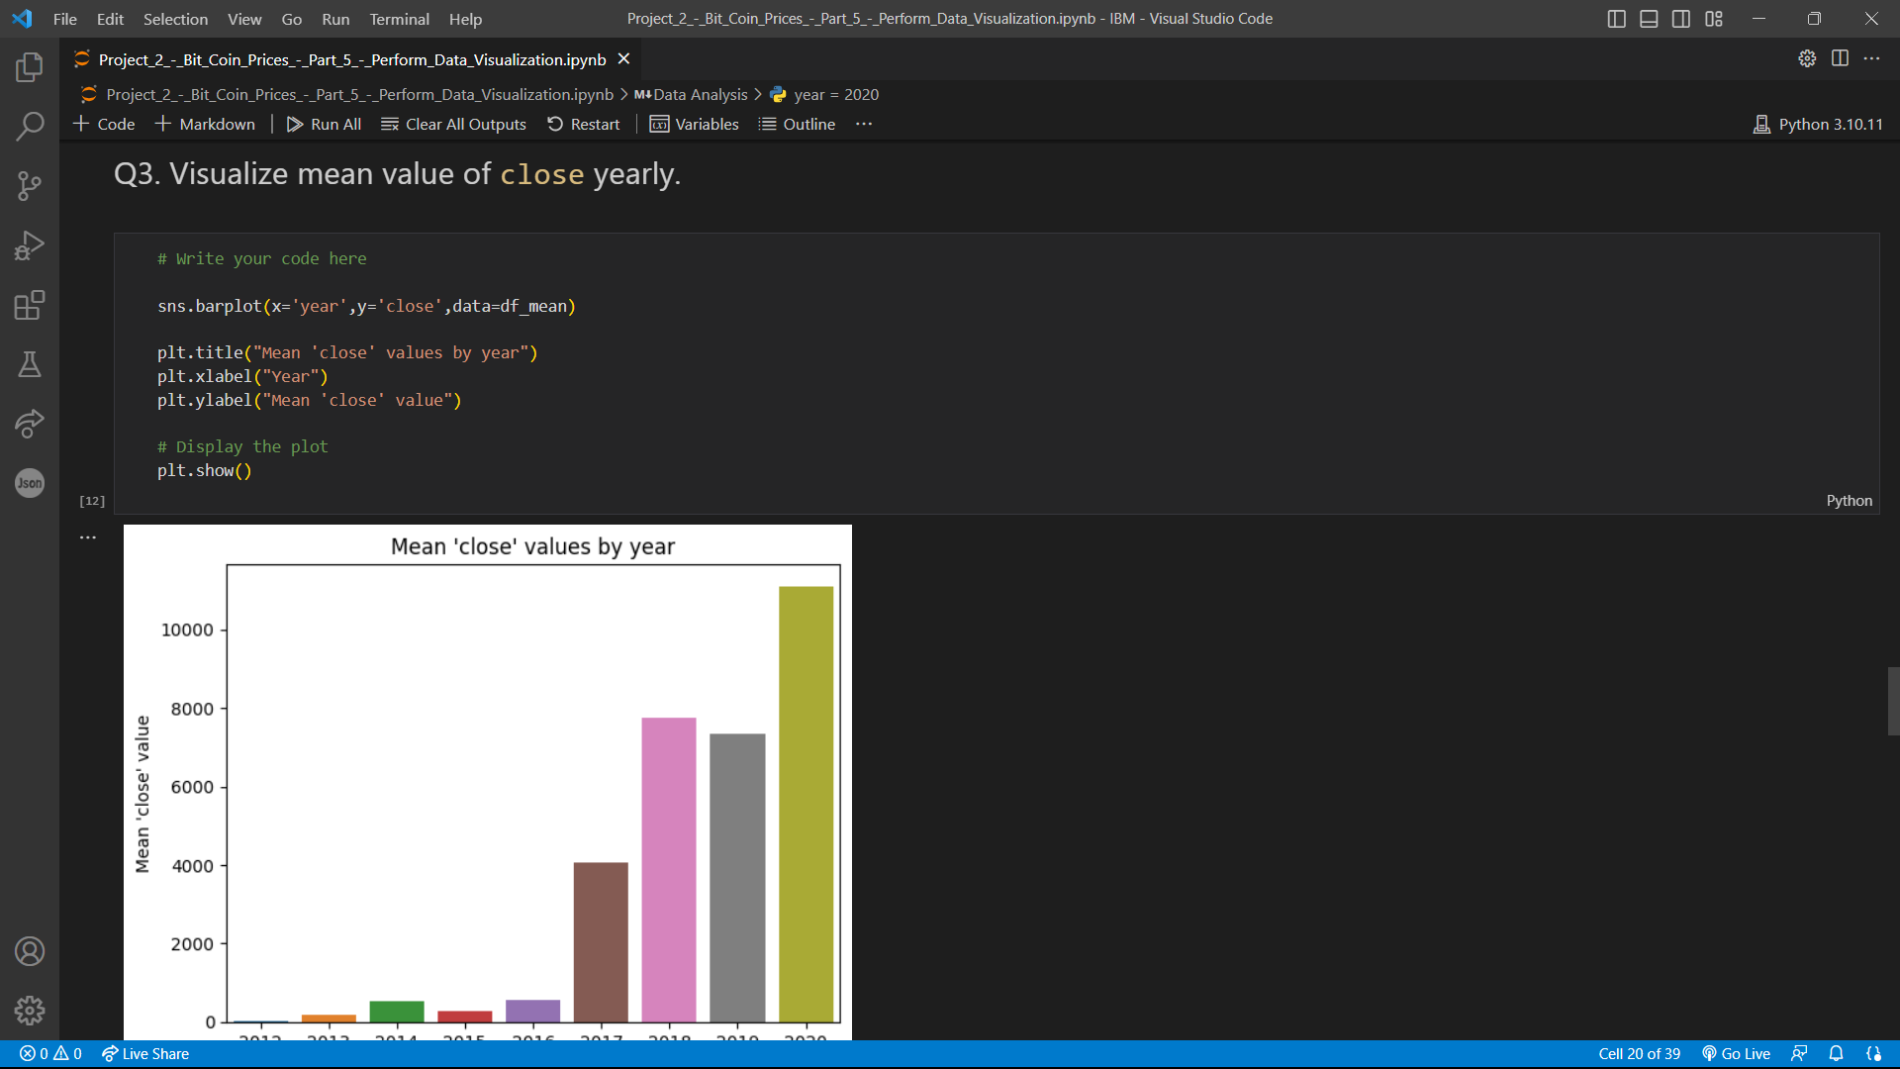

Slide 28
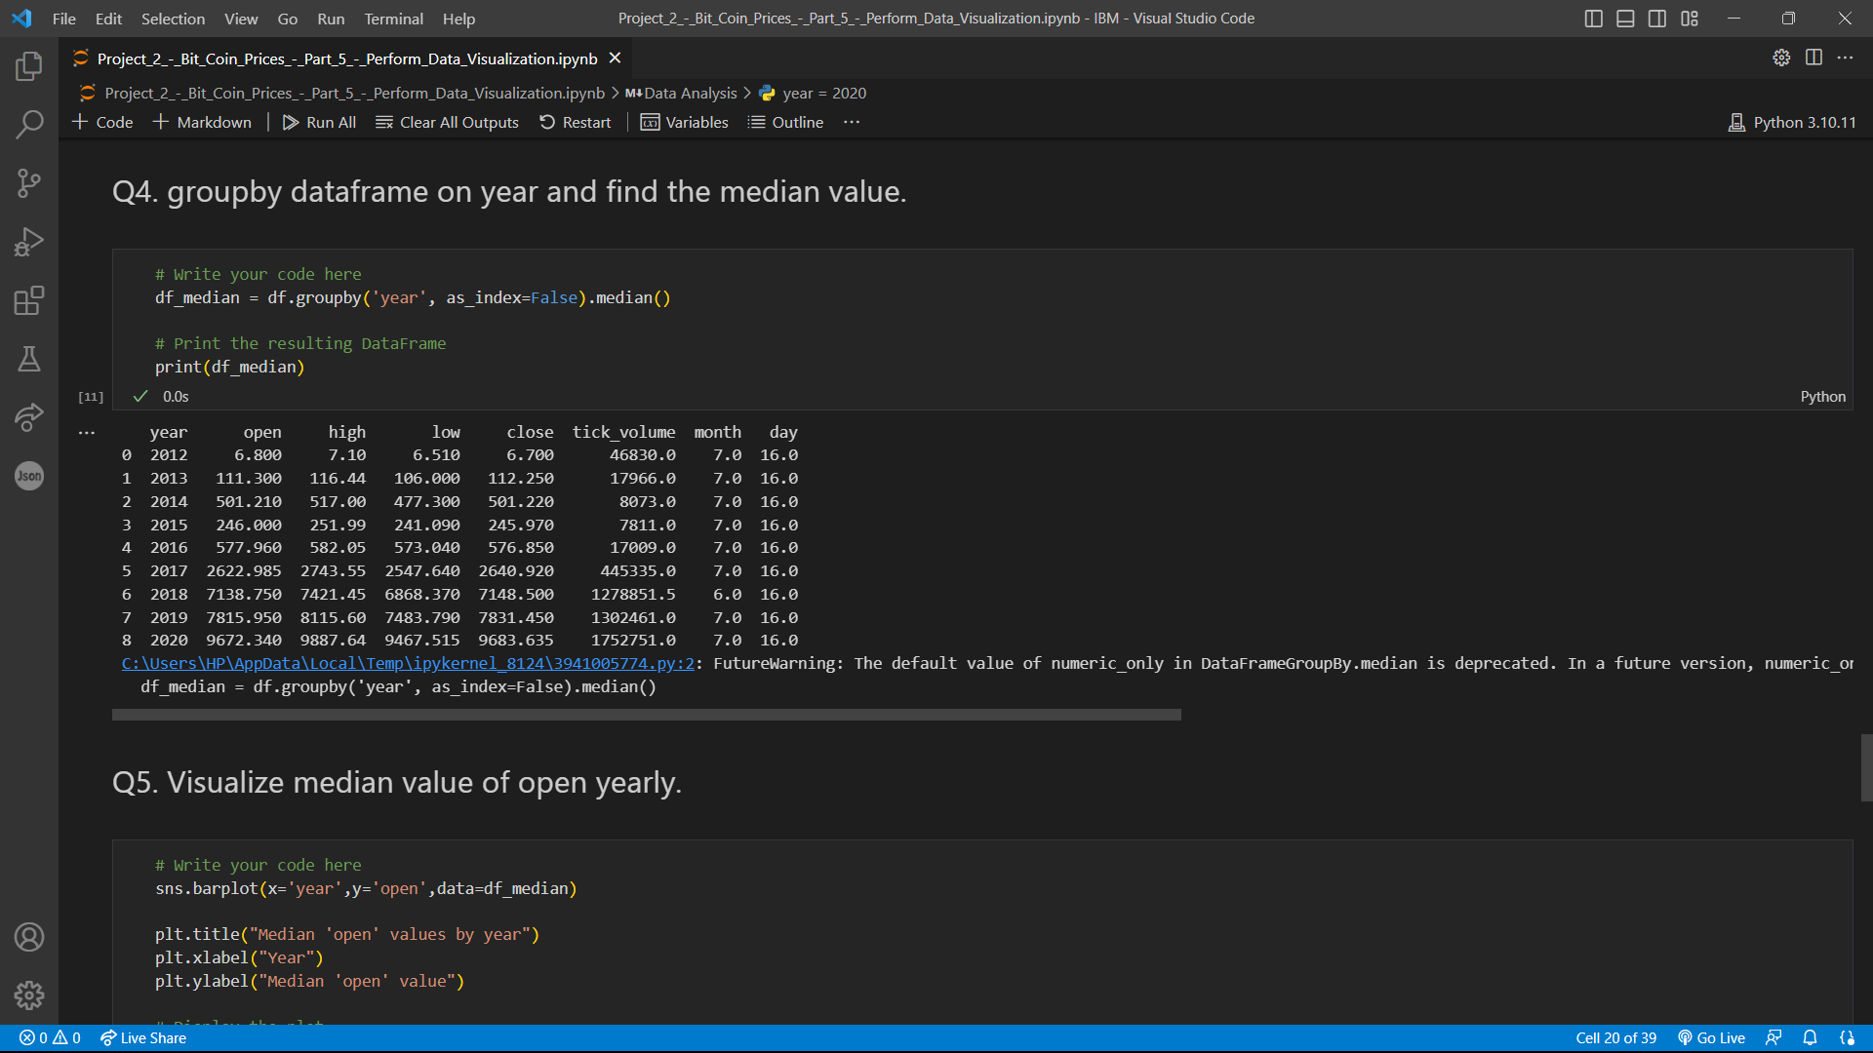

Slide 29


Slide 30
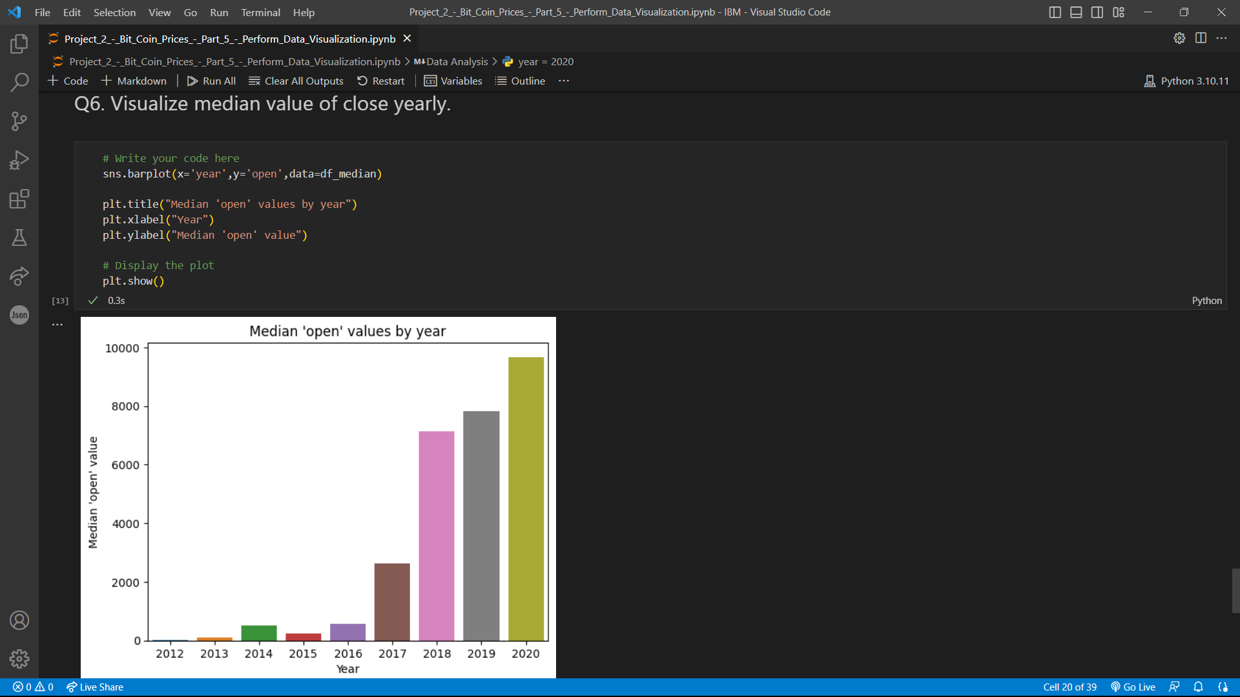

Slide 31
Module-6_Model Development and Evaluation
Summary:
The code in this module splits a dataset into training and testing sets using the train_test_split() function from sklearn.model_selection. It then creates a Linear Regression model and fits it to the training data. The model's performance is evaluated on the testing set using mean squared error and R-squared metrics. Finally, the mean squared error and R-squared values are printed to the console.

Slide 32
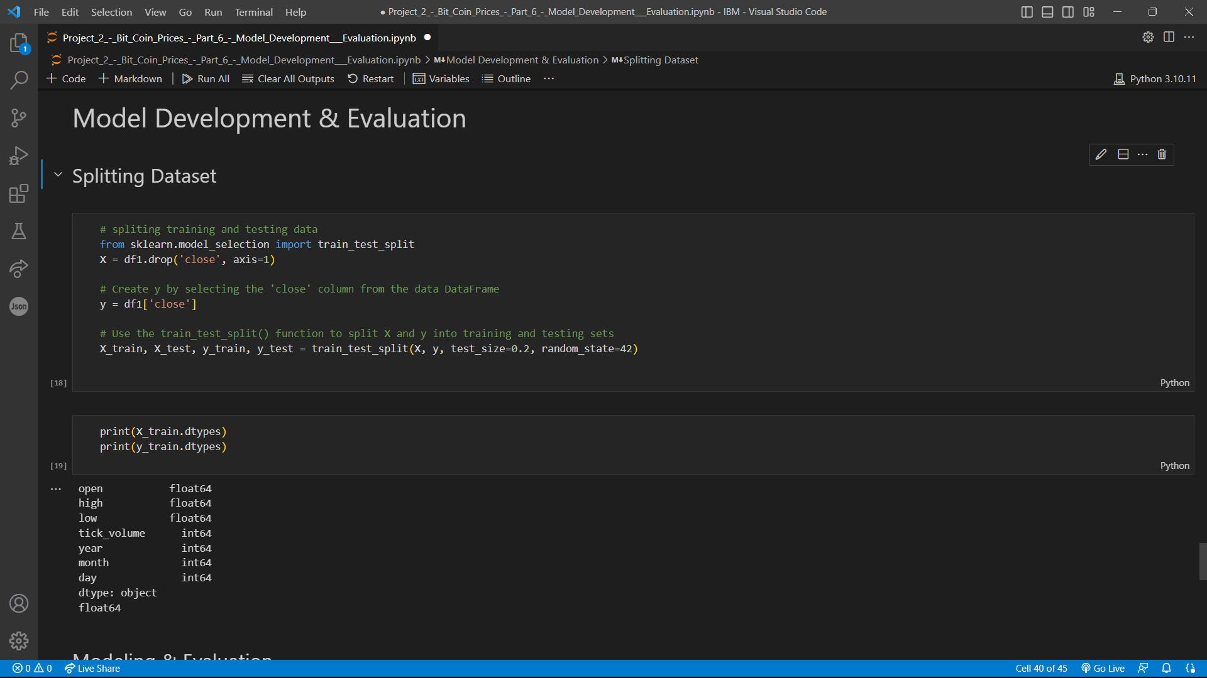

Slide 33
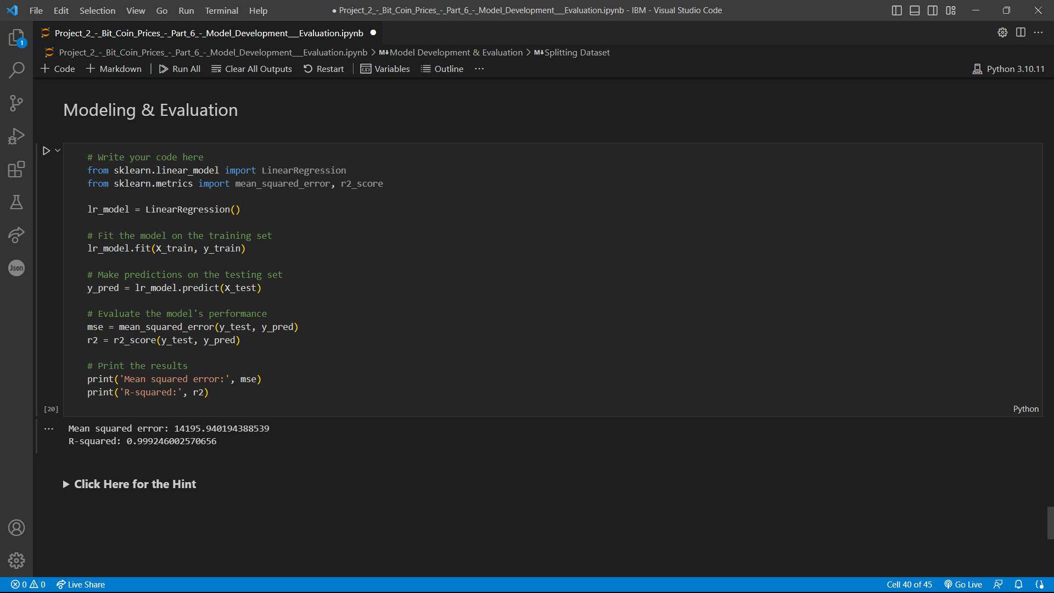

Slide 34
TEST CASES FOR THE MODEL
Bitcoin Prices – Team A

Slide 35
Test case for data preprocessing:
Input: a CSV file containing Bitcoin price data with missing values and incorrectly formatted date columns
Expected output: a preprocessed dataset with correctly formatted date and price columns, missing values handled appropriately, and no duplicate rows

Slide 36
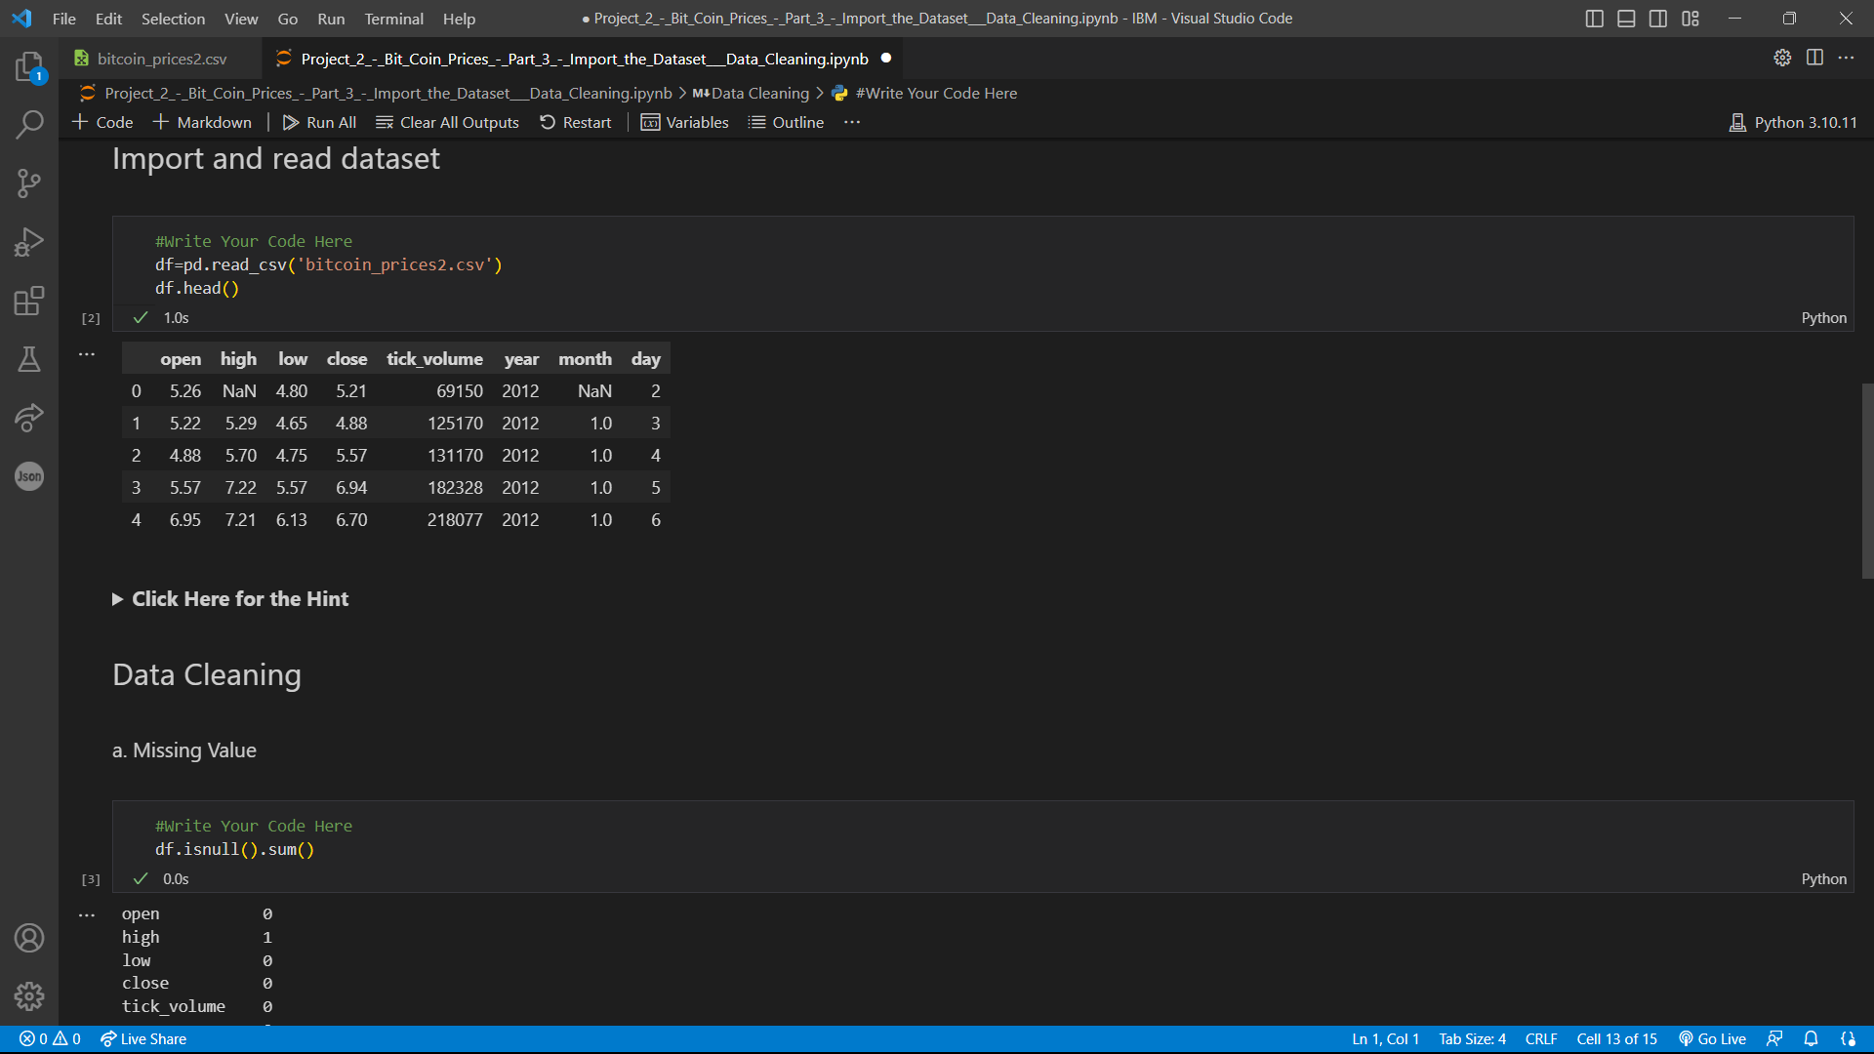
Here the Incorrectly formatted datetime columns is shown as ‘Nan’ which is NULL

Slide 37
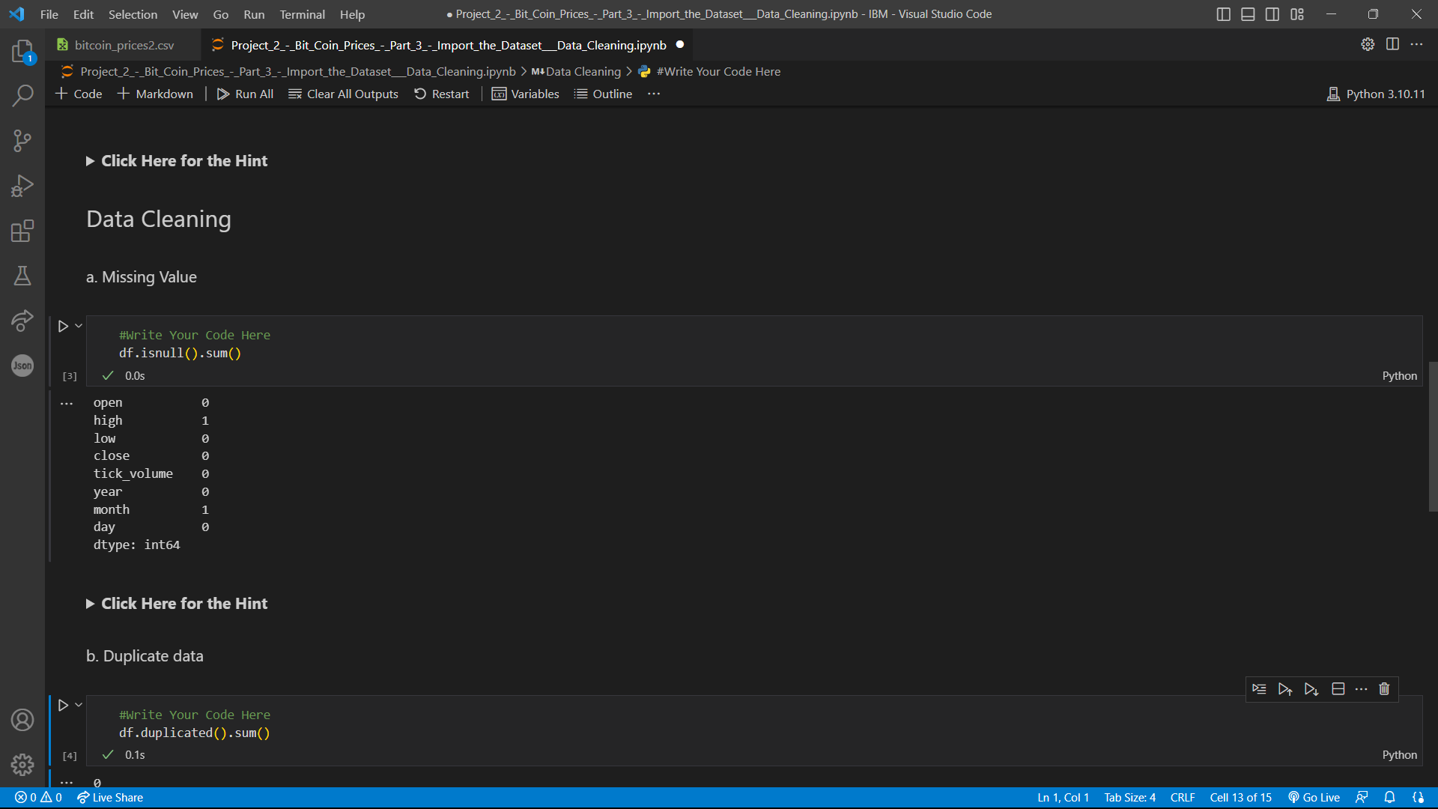
Missed Values Handed Appropriately

Slide 38
2. Test case for data visualization:
Input: a preprocessed dataset containing Bitcoin price data
Expected output: visualization plots (e.g., bar plots) that show the trend and distribution of Bitcoin prices across different years, months, and other relevant features

Slide 39
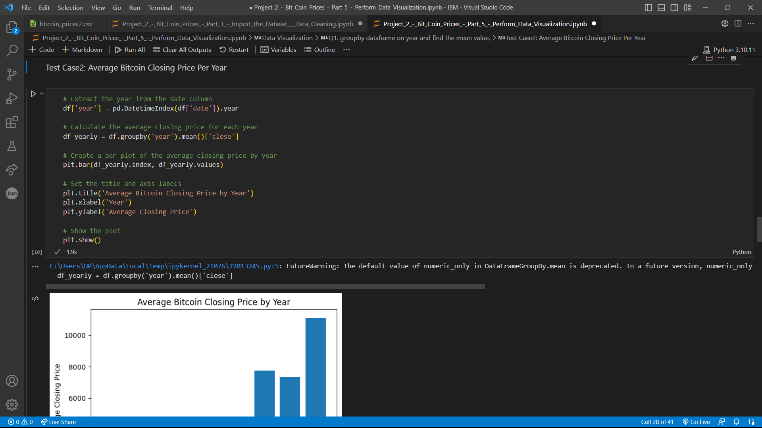

Slide 40
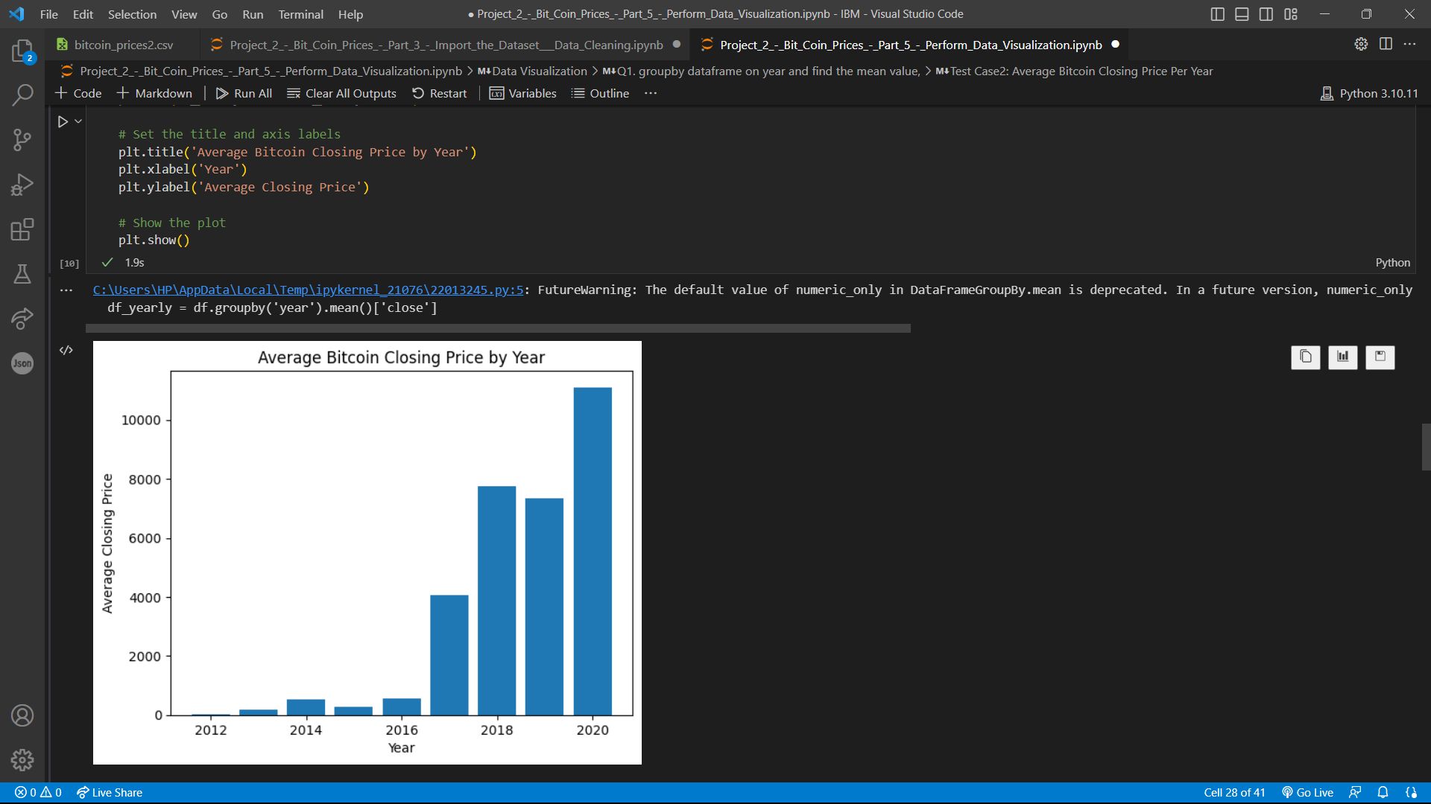

Slide 41
3. Test case for model evaluation:
Input: a trained linear regression model and a testing dataset containing Bitcoin price data
Expected output: performance metrics such as mean squared error (MSE) and R-squared score that indicate how well the model is able to predict Bitcoin prices on the testing dataset

Slide 42
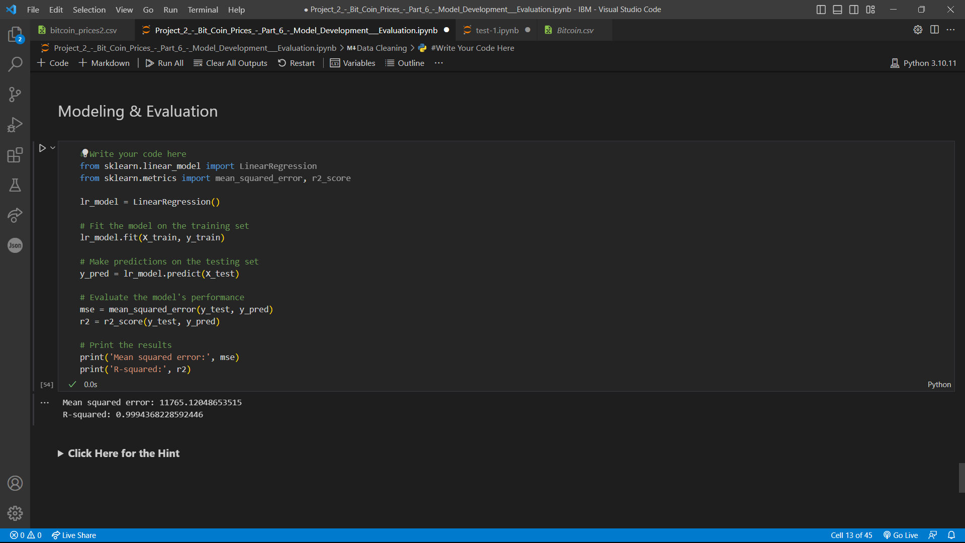
Solved !

Slide 43
4. Test case for model training:
Input: a preprocessed dataset containing Bitcoin price data, split into training and testing sets
Expected output: a trained linear regression model that can predict Bitcoin prices based on the input features, with reasonable accuracy on the testing set

Slide 44
TEST CASE - 4
To obtain the expected output, we need to train a linear regression model on the preprocessed dataset containing Bitcoin price data, which has been split into training and testing sets. The model should be able to predict Bitcoin prices based on the input features with reasonable accuracy on the testing set.
Once the model is trained, you can use it to make predictions on new data and evaluate its performance using metrics such as mean squared error and R-squared. The goal is to obtain a model with low mean squared error and high R-squared values, indicating good predictive accuracy.
And by specifiying the test_size=0.67, it gives the lowest Mean-squared Value=11765.1204 ever seen in this given dataset.

Slide 45
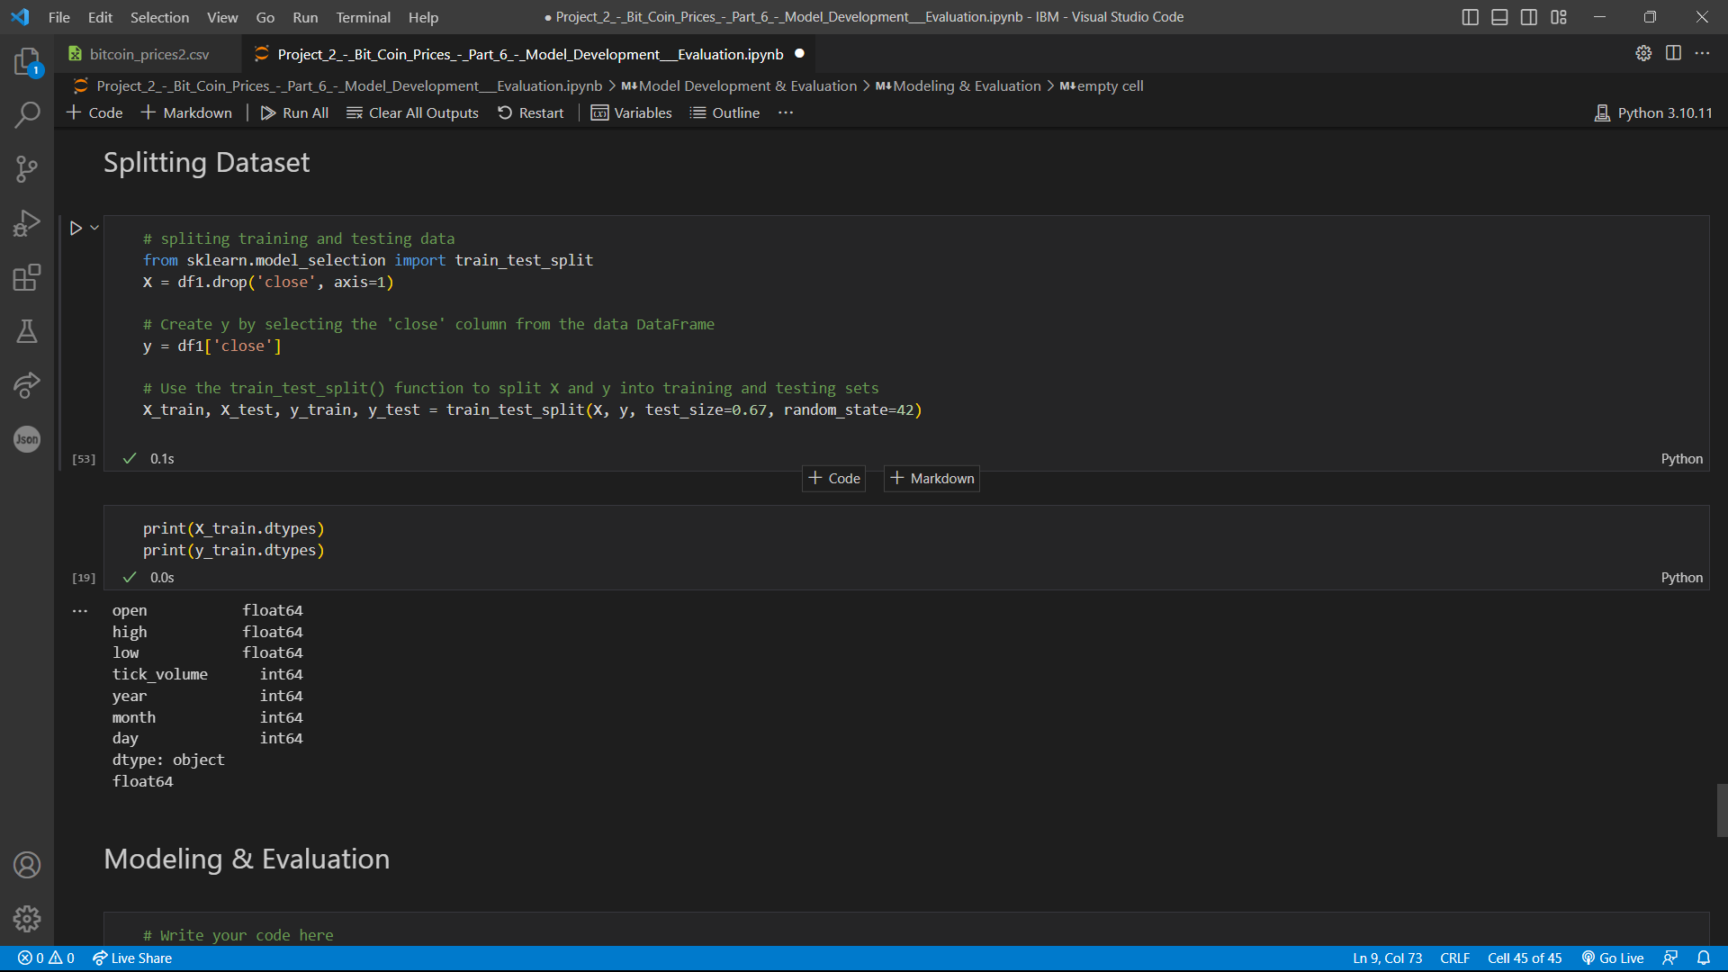
By giving test_size=0.67

Slide 46
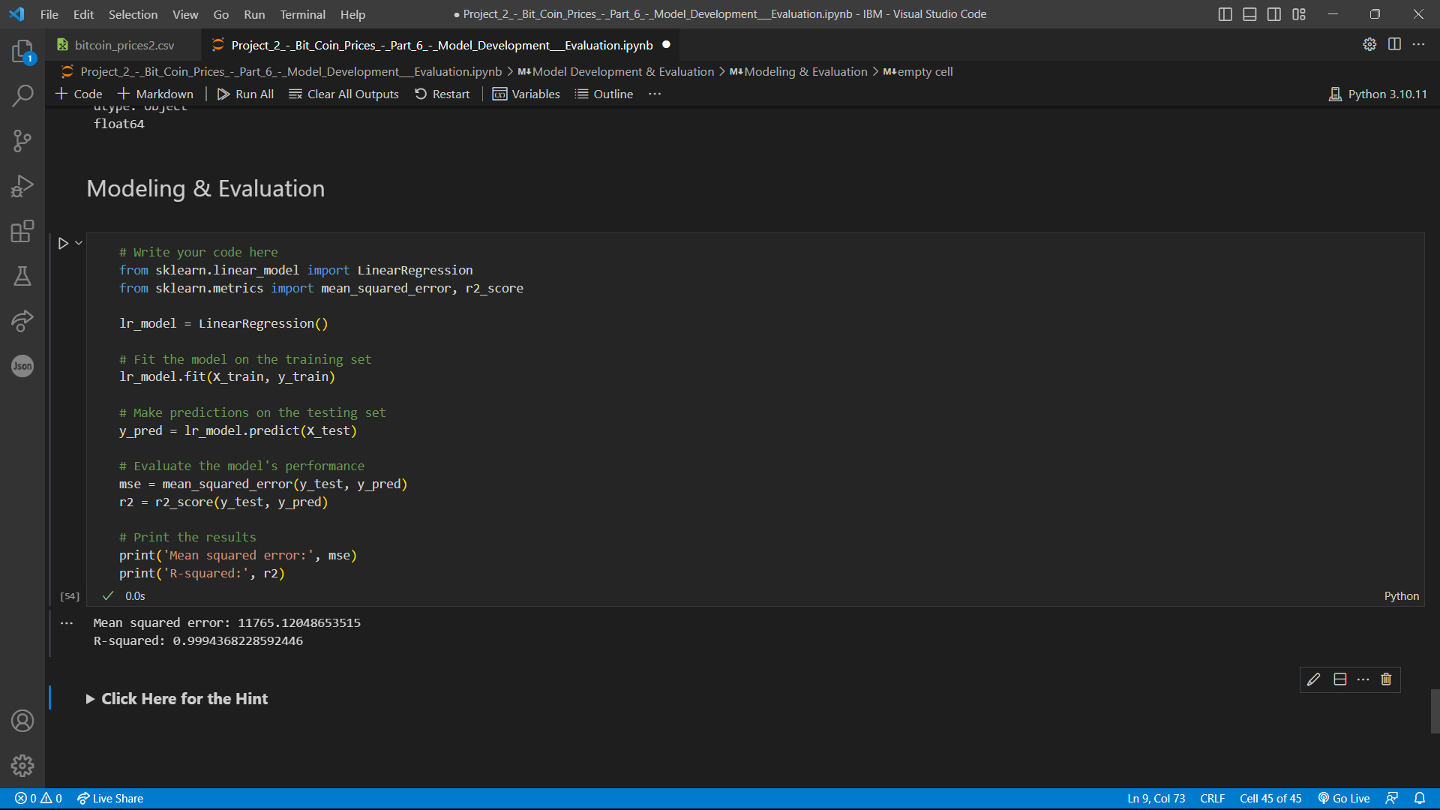
Lowest Mean-squared Error

Slide 47
5. Test case for model deployment:
Input: a trained linear regression model, a preprocessed dataset containing new Bitcoin price data, and a set of input features for the new data
Expected output: a predicted Bitcoin price for the new data based on the trained model
Here, We are taking a random dataset from Kaggle and Our trained-model with same test_size=0.67 to test case of Model Deployment as it predicts the Bitcoin Price for the new dataset for minimum Mean-squared Error.

Slide 48
TEST CASE – 5 Solution:
The input for the test case includes a trained linear regression model, a preprocessed dataset containing new Bitcoin price data, and a set of input features for the new data.
The expected output is a predicted Bitcoin price for the new data based on the trained model. The linear regression model with the new dataset as input argument. The output will be a predicted Bitcoin price based on the trained model and the new input features.

Slide 49
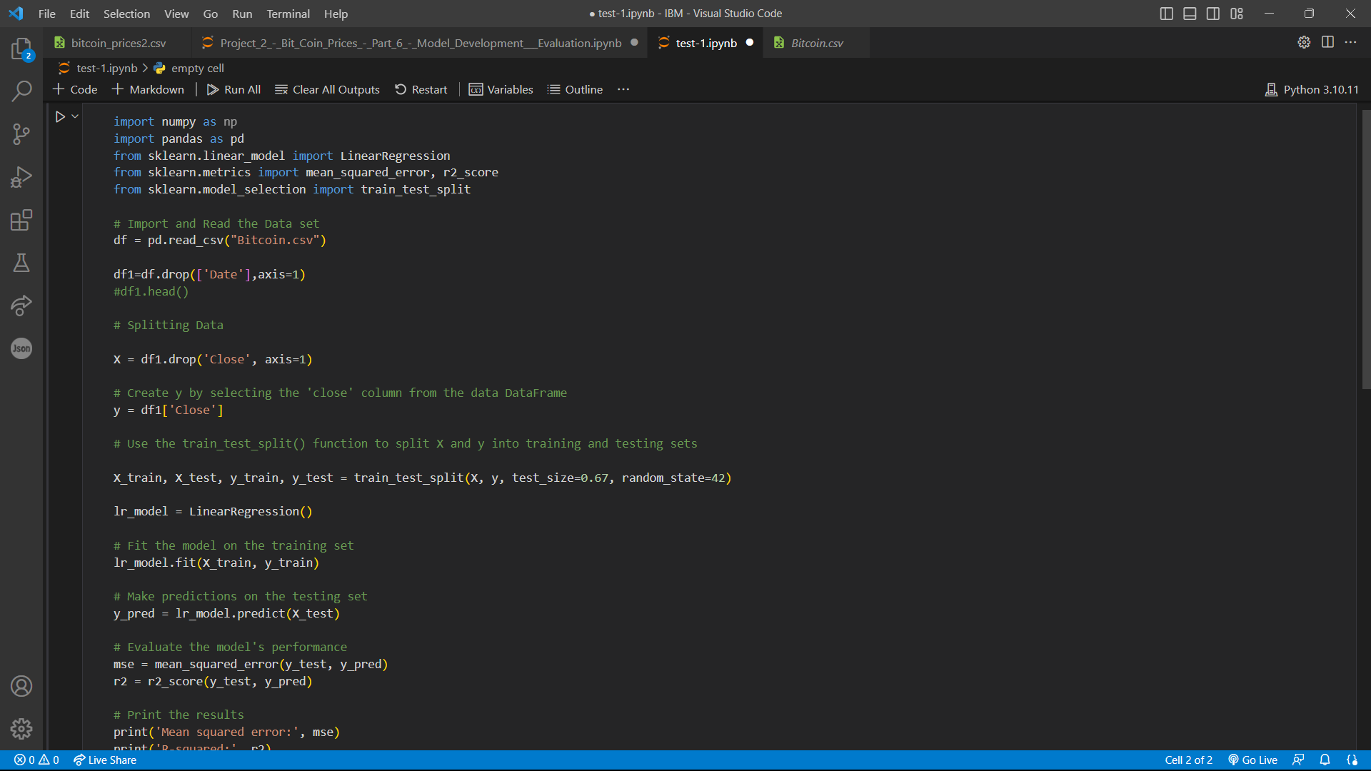
A random dataset from Kaggle has been taken and worked here.

Slide 50
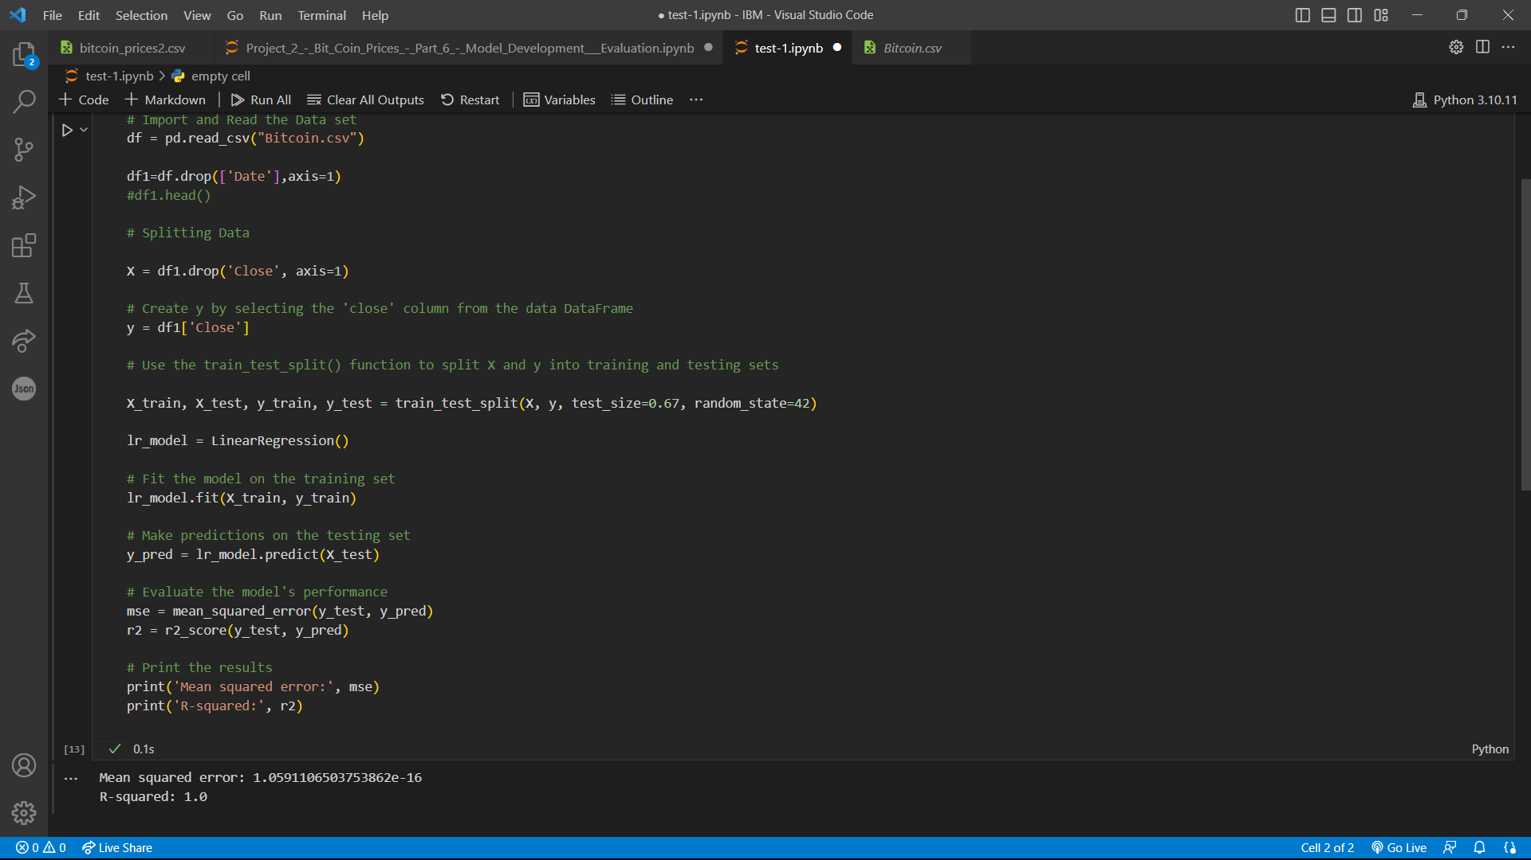
test_size=0.67
Minimum Mean Squared Error

Slide 51
Uses:
Data preprocessing: The code uses pandas to load and preprocess the historical Bitcoin price data.
Numeric Operations: In this project, Numpy module in python is used to carry various Numeric Operations.
Data visualization: The code uses seaborn and matplotlib to create various visualizations of the Bitcoin price data.
Model training and evaluation: The code uses sklearn to train a Linear Regression model on the preprocessed data and evaluates its performance using mean squared error and r-squared.

Slide 52
Merits:
The code uses popular libraries and best practices for data preprocessing, visualization, and modeling in the data science community.
The Linear Regression model used in the code is a simple but effective approach for modeling the relationship between Bitcoin prices and the other features in the data.
Demerits:
The code only uses a single model (Linear Regression) and could benefit from trying other models to improve performance.
The code could be improved by including more advanced techniques for feature engineering and selection, such as PCA or Lasso regression.

Slide 53
Conclusion:
Overall, the code provides a good foundation for a Bitcoin price prediction project and demonstrates some of the essential techniques and libraries used in data science. However, there is still room for improvement in terms of model performance and feature engineering.

